Slide 1
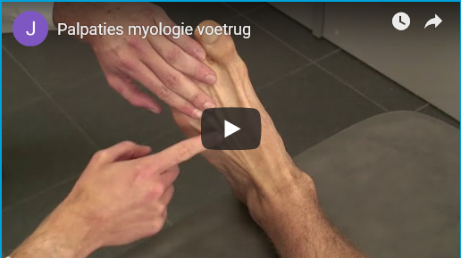

Videos and knowledge clips
The Why, What & How from a didactic viewpoint
Jan Hensgens, Maryam Asoodar & Ilse Sistermans
Maastricht Universiteit
id_elearning@maastrichtuniversity.nl
From: https://anatomytool.org/
Notes:
Hi we are a projectteam of the teaskgroup Instructional Design and eLearning and our goal is to promote and support the use of videos in Education. I am Jan Hensgens, this is Maryam Asoodar of O&O and this is Ilse from the University Library. We plan to make this lecture interactive and expect your involvement. But let us start here.

Slide 2
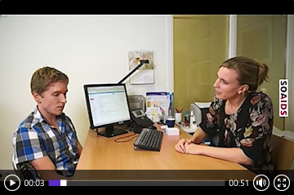

Slide 3


First impressions clip1
From: http://pngimg.com/
Notes:
Please give us your first impressions about the clip shown.

Slide 4

First impressions clip 1
What is the context?
What is expected from you?
Why is it relevant?
What is the message?
Recording quality?
……….
From: http://pngimg.com/
Notes:
We expected that these questions have been raised in the brainstorm.

Slide 5
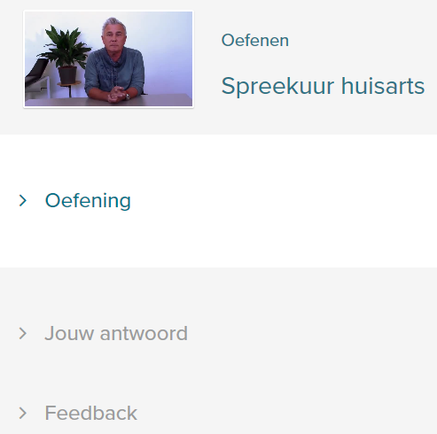
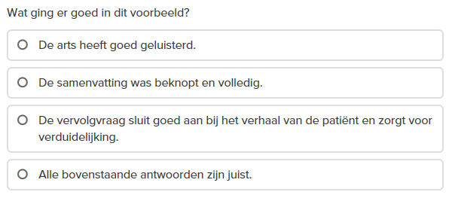
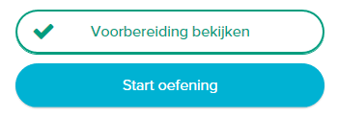

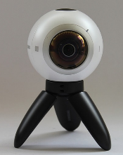
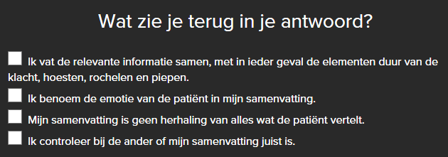
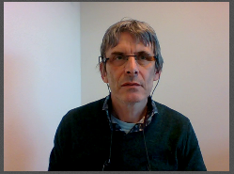
Training: Listen, summarise and ask questions
Consultation Family Doctor
From: https://ru.traintool.com/go/preview/7ff8a78d6afdb2ee
Notes:
The clip shown is part of a student training for first year medical students of the Radboud University. After watching this introduction video the students fill in a short questionnaire to prime the main criteria for a good start of a consult. Afterwards they start the exercise watching a patient, who introduces himself and his reason to visit. The student records his/her summary and the follow-up question(s), watches the own recording, checks whether it fits the expectations by using the provided criteria and sends it into the system whenever he/she considers the recording satisfactorious.

Slide 6



Second impressions clip 1
The context
What is expected
The relevance
The message
Recording quality
……….
From: http://www.picpedia.org/ Author: Nick Youngson
Notes:
What was unclear after showing the isolated clip is now clarified by the integrating context of this training.

Slide 7
Overview
Introduction and learning goals
What, why and how about knowledge clips
Effective use
How to develop
Some aspects of quality
Notes:
In this lunch lecture we will discuss the following points:
What you will learn in this lecture/workshop
We will zoom into the background of knowledge clips
How videos can be used effectively in education
How to design and develop these videos and what should be considered doing this
And some aspects about the quality of videos for higher education
During this lecture/workshop you will be asked to interact with us and the audience

Slide 8
Introduction and learning goals
Focus to a didactic viewpoint
  Embedding (aligning) clip with education
  Activation of the learner
Goals of this lecture/workshop to
  know the different clip formats
  know how to design effective clips
    using educational scenarios and scripts
  know how to assess didactic quality aspects for clips
Notes:
You will notice that the chosen focus is how to integrate the videos as learning material into your education.
The most important added value is what your students with the clip do or are supposed to do.
Activation during and after watching are excellent means to maximise the intended learning effects.
Consider quizes, exercises or invite the viewer to get involved in the thinking processes by providing pauzes before presenting the answers.
After this lecture/workshop
you will know the different video formats and which fits best with your education.
you will understand how to design effectieve clips and how educational scenarios and scripts will support the developing processes.
Finally, you can recognize and assess the didactic quality of your own or an existing clip in the perspective of reuse.

Slide 9
What makes clips relevant for FHML?
Which goals
Features
Educational scenarios
Brainstorm
Discuss these in duos for 4 minutes
Go to https://www.wooclap.com/FHMLCLIPS/
Use 2 keywords/phrases per category to report your findings
Notes:
Before continuing my presentation I want to consult your existing ideas about the following three questions:
Why would you consider to use knowledge clips?
What are the features of a knowledge clip?
Which educational scenarios would you prefer for your education?
Discuss five minutes with your neighbour about these categories. Extract keynotes from this discussion and insert these in Wooclap using your laptop of smartphone. The internetaddress is shown in this slide.

Slide 10
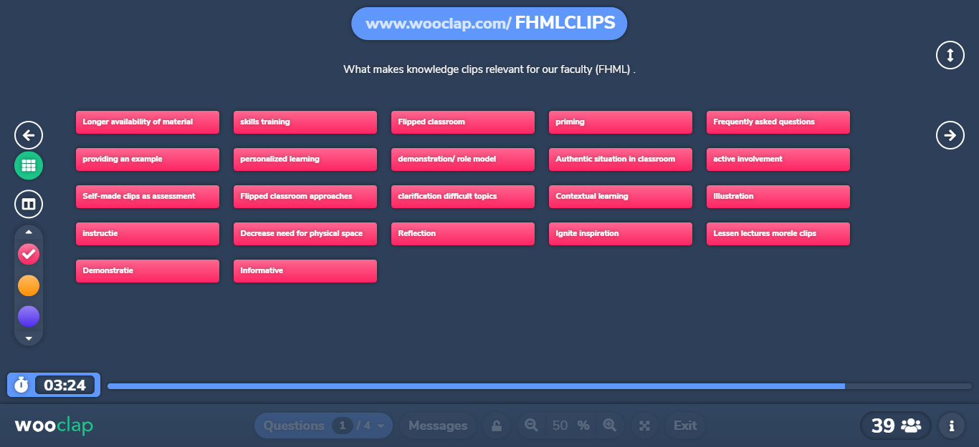
Results: The goals

Slide 11
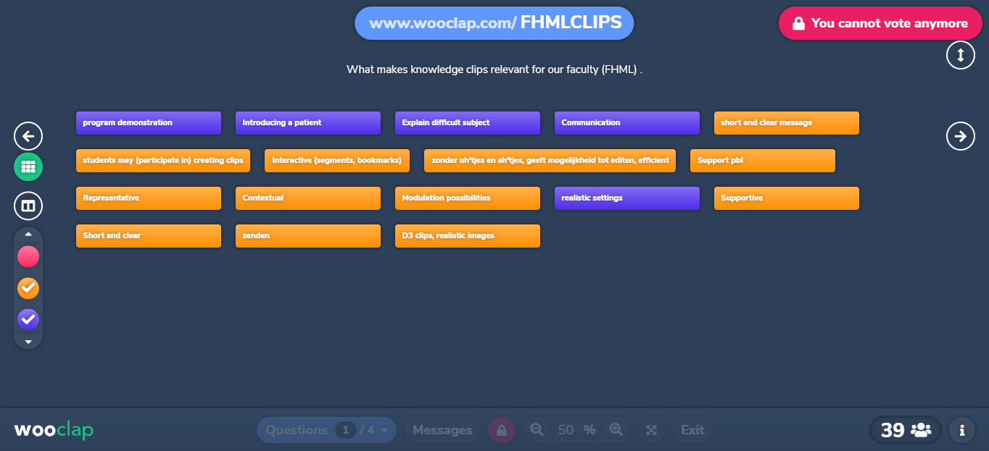
Results: The what & educational scenarios

Slide 12
What, why and how about knowledge clips
What
  video-recording - one subject completed
  max 5 minutes - self-contained
  personalised - online (asynchronous)
Why
  flexible (wwhr) - preparation (flipped classroom)
  selfstudy/reference - remediation/additional material
  specific learning goals - personalised learning (GEN/ITM)
Notes:
Let us consider the what and why based on the current experiences and as described in the literature.
What: A knowledge clip is a video of about 5 minutes in which you explain a specific theme.
For example a complex notion, a difficult formula or a subject which students regularly seem to have difficulty dealing with in an exam.
Students are able to watch the clip (repeatedly) where and whenever they please.
A good clip can be used as a stand-alone item.
Why: The clip is flexible and can serve a more diverse group of students.
It can be used as preparation to apply the knowledge in the classroom.
Other reasons are for self-study, remediation or addition, to serve specific learning goals or ro support personalised learning.
More about this in the following slides

Slide 13

What, why and how about knowledge clips
Scenario (video and educational use)
  Introduction video
Notes:
In an introduction video the teacher introduces herself or the course.

Slide 14
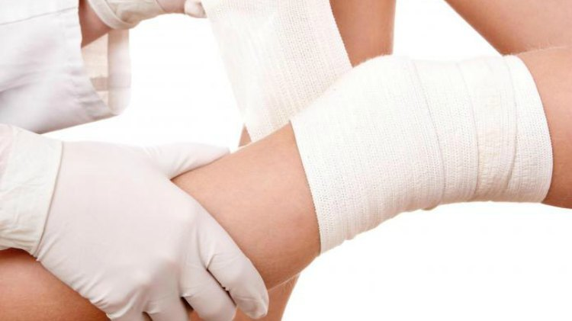
What, why and how about knowledge clips
Scenario (video and educational use)
  Introduction video
  Skills clip
Notes:
The skills clip shows and demonstrates a skill.

Slide 15
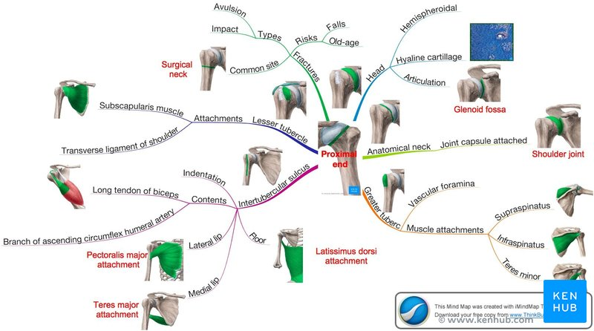

What, why and how about knowledge clips
Scenario (video and educational use)
  Introduction video
  Skills clip
  Knowledge clip
Notes:
The knowledge clip is ideal for explaining a coherent concept with its relationships.

Slide 16


What, why and how about knowledge clips
Scenario (video and educational use)
  Introduction video
  Skills clip
  Knowledge clip
  Feedback clip
Notes:
The Feedback clip gives you the opportunity to give extensive (frequent) feedback, which the student can process at his own time and pace. This can be efficient for the teacher.

Slide 17


What, why and how about knowledge clips
Scenario (video and educational use)
  Introduction video
  Skills clip
  Knowledge clip
  Feedback clip
  Rolmodelling video
Notes:
In the role modeling video, the professional in action is shown in an actual or simulated context.

Slide 18


What, why and how about knowledge clips
Scenario (video and educational use)
  Introduction video
  Skills clip
  Knowledge clip
  Feedback clip
  Rolmodelling video
  Interview the expert
Notes:
Often the expert is not directly accessible to students when needed, an Interview with the expert can offer a solution.
If this expert was previously brought into the lecture to transfer his knowledge, his available time could afterwards be used to give feedback on the application assignments.

Slide 19
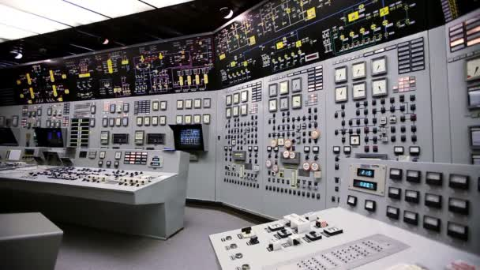

What, why and how about knowledge clips
Scenario (video and educational use)
  Introduction video
  Skills clip
  Knowledge clip
  Feedback clip
  Rolmodelling video
  Interview the expert
  Surroundings video
Notes:
Sometimes a work environment can be inaccessible (because of danger, disruption of processes or the like), then an environment video can provide a solution.

Slide 20


What, why and how about knowledge clips
Scenario (video and educational use)
  Introduction video
  Skills clip
  Knowledge clip
  Feedback clip
  Rolmodelling video
  Interview the expert
  Surroundings video
  Assessment clip
Notes:
The learning effects of the pre-cooked knowledge clips cover mainly "shallow learning".
To assess to what extent a student the learning goals had been mastered, a video assignment can be used.

Slide 21
What, why and how about knowledge clips
How (technical formats)
Explanation of clip formats (3:03 min)
Notes:
Let us continue with a possible set of technical clip formats which can be used.

Slide 22
Exercise
Select in 2 minutes
  The 3 or 4 most valuable formats for your education
Go to https://www.wooclap.com/FHMLCLIPS/
Notes:
Now it's your turn again. I ask you to indicate the expected usefulness of each format for your education. You have 4 minuets to divide a hundred points over these formats in Wooclap.

Slide 23
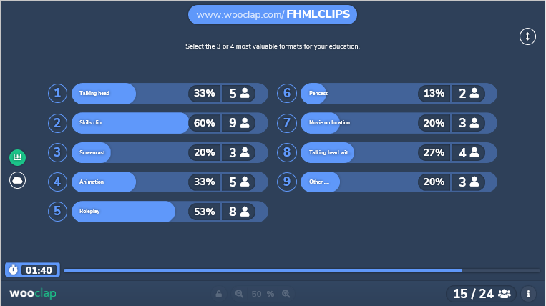
Results: The usefulness of formats

Slide 24
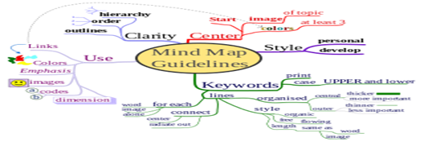



Effective use?
Align video content with learning activity & goals
Mind mapping
Group discussion
Assessment during/after video
Assignment after video
Notes:
As already stated, the effectiveness of the video is largely determined by what you let the students do with it.
It can be a preparation for a group discussion or role play, you can ask them to draw a mind map based on the shown information, you can assess the student with quizzes or questionnaires during or give them an assignment afterwards.

Slide 25
Effective use?
Integrate in own education as learning material
  Start from a learning context/scenario
  State explicit learning goals to be served
  Start with a search for existing clips which fit
    Check whether target groups match
    [optional] extend it with instructions/interpretations
    Design and produce your own clip
  Decide how to activate the learners
  Using clips ➔ adapt your education
Notes:
If you are considering using video, the main concern must be how it will be integrated into your education.
Start with an explicit educational context.
Specify the learning goals and how video can contribute to these.
The first action should be to search for existing or adaptable clips which match your target group.
Decide for own production only if nothing suitable can be found.
Ensure that you activate your viewers.
Be aware that by using clips the education starts to change.

Slide 26
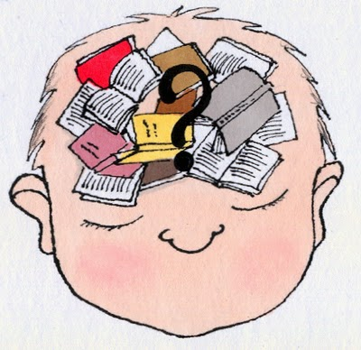

How to design?
Design learning material using video
  know/activate prior knowledge
Notes:
Determine the prior knowledge and consider how to activate it.

Slide 27


How to design?
Design learning material using video
  know/activate prior knowledge
  explicit learning goal(s)
Notes:
Make your learning goals specific and use the SMART approach here, as this gives input about how to assess or activate your learners during the video and afterwards.

Slide 28

How to design?
Design learning material using video
  know/activate prior knowledge
  explicit learning goal(s)
  activate learner
    during watching
    afterwards (assessment?)
Notes:
Decide how you want to activate your learners, which techniques are you using? Options are quizzes, questions, discussions etc.

Slide 29
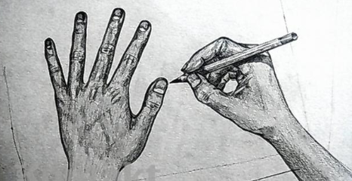

How to design?
Design learning material using video
  know/activate prior knowledge
  explicit learning goal(s)
  activate learner
    during watching
    afterwards (assessment?)
  select format and approach
    visualisation
Notes:
Make a provisional choice for the clip type with the best fit to your treated subject matter.
Search for visualisations which support or complement your information.
For instant flow charts are excellent visualisations for complex processes.

Slide 30
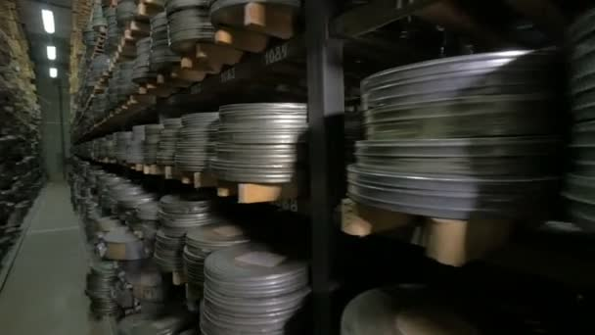

How to design?
Design learning material using video
  know/activate prior knowledge
  explicit learning goal(s)
  activate learner
    during watching
    afterwards (assessment?)
  select format and approach
    visualisation
    accessibility & copyrights
Notes:
Check whether the visualisations and data are accessible at the needed time.
Ensure that you have the correct copyrights for all used subject materials.

Slide 31
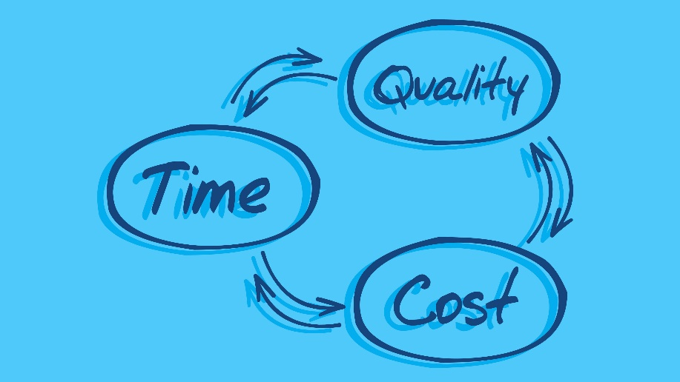
How to design?
Design learning material using video
  know/activate prior knowledge
  explicit learning goal(s)
  activate learner
    during watching
    afterwards (assessment?)
  select format and approach
    visualisation
    accessibility & copyrights & informed consent
    budget/expertise/time
Notes:
Check your budget, the expertice available and the available time (working hours but also lead time).
This will determine your possible ambitions.

Slide 32
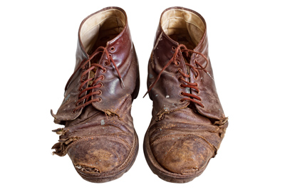
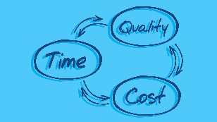
How to design?
Design learning material using video
  know/activate prior knowledge
  explicit learning goal(s)
  activate learner
    during watching
    afterwards (assessment?)
  select format and approach
    visualisation
    accessibility & copyrights
    budget/expertise/time
    life cycle
Notes:
Finally is the expected life time of the knowledge clip an important factor.
If the covered subject matter will be consistent and correct over a long time, more resources can be used and a better quality can be justified.

Slide 33
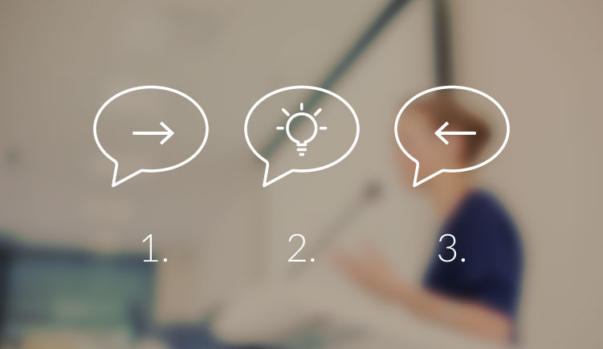
How to design?
Structure of knowledge clip
Start
Introduction
Topic
Learning goals
Middle
Discuss topic
End
Summary
Repeat learning Goals
(Call to action – assignment)
Notes:
Always tell what you are planning to tell, tell it and tell what you have told. The simple structure consist of:
1. START
Introduce yourself.
Identify the subject, learning goals and length of the video.
Explain what action/output you expect from the student
2. MIDDLE
Discuss the subject.
Relate theory to practice when and where possible.
If you asked questions in the introduction, provide answers.
3. END
Provide a concise summary.
The learning goals.
If needed, give an assignment.

Slide 34

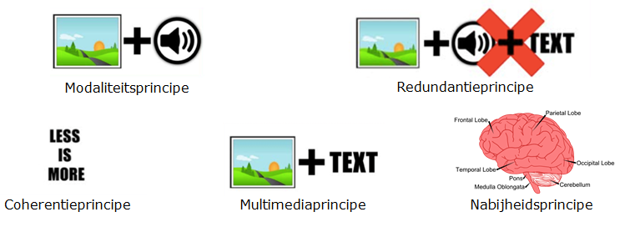

How to design the video?
Use Multimedia design principles of Mayer
1 topic
address viewer personally
2-5 min
Segmentationprincipe
http://www.digitaledidactiek.be/modules/2-ontwerp/theorie/mayer/mayers-ontwerpprincipes-van-multimedialeren/
Notes:
If structure and approach are chosen you are ready for the clip design.
Use the design principles of Mayer as are presented in the clip you were asked to watch as preparation for this session.
It emphasizes that a knowledge clip is most effective when it is
short 2-5 minutes
covers one topic only
serves clearly defined learning goals
combines pictures and words and avoids redundancy
1 multiple representations- multiple representations: combine words & images
2 contingency – present words and images close to each other and simultaneously
3 coherence - avoid using unrelated material (only distracting)
4 modality - spoken text is better than written text
5 redundancy – spoken text does not need written text
6 segmentation – cut information into meaningful parts

Slide 35
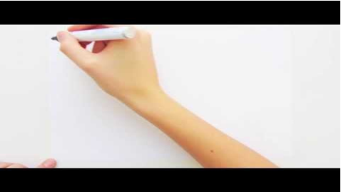
https://youtu.be/GnVJx2QKWkE

Slide 36
Exercise
2 minutes to grade as duos the shown video
To enable submission all scales must be > 0
Go to https://www.wooclap.com/FHMLCLIPS/
Notes:
Use 4 minutes to grade in pairs the previous video clip in Wooclap.

Slide 37
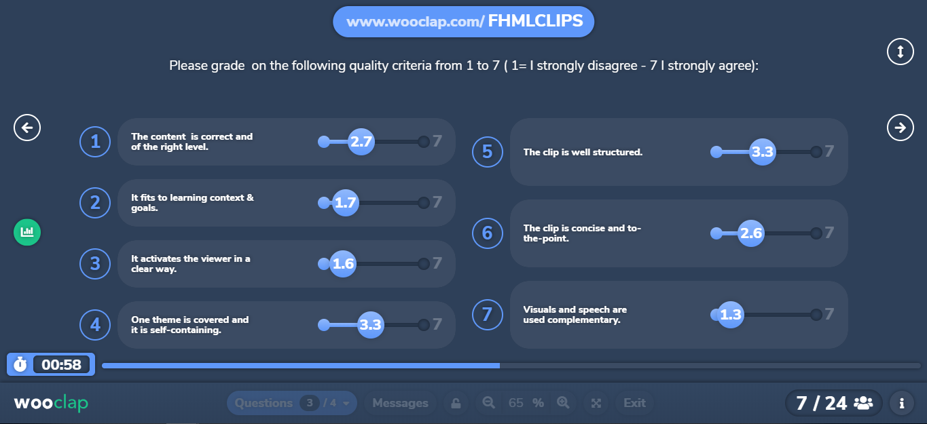
Results: grading knowledge clip

Slide 38
Grading a knowledge clip – take aways
Remains as stand-alone item difficult
  Visual design
  Multi-media principles
Depends on the didactic embedding
  Good videos can become bad educational practice
  Bad videos can become excellent educational practice
Focus on the embedding
Notes:
You will have noticed that the grading of a stand-alone clip remains difficult. Probably you will have a good idea about the visual design and the used multi-media principles. But the usefullness correlates with the here unknown educational embedding. Good quality clips can become bad educational practice and vice versa. So keep your focus on the contextual and didactive embedding.

Slide 39
Summary: how to design knowledge clips
State the learning goal(s)
How a clip contributes to that goal(s)
What will be expected from the learners
Which content and format of the clip
Integrate clip in course
Collect visualisations
Write a concise script
Notes:
I want to conclude with a short summary of designing a knowledge clip.

Slide 40
How to produce a video: steps
Determine didactic goal or role
Aling video with learning activities
Write brief
Select a format
Write script
Collect visual resources
Choose a location
Get feedback
Lights camera action!
Edit video
Publish video
Conceptual phase
Pre-production phase
Production phase
Publication phase
Notes:
Long process – Important to follow the steps! Good preparation >> quality >> less time on time/money consuming editing
Step 1 – decide on your target audience and what the goal of your video is. What are you trying to communicate. Is a video the best way to communicate it. What is the role. Is it part of a series? Should it be used in different contexts? etc…
Step 2 allign with learning activities
Step 3 write a brief (scenario)
Step 4 choose a format – >> suitable for message and budget
Step 5 write a script – Is important step!!! Good preparation is key!
Step 6 collect visual resources (so if in scenario you decided to use schematic representations, or picture of a lab set-up, these pisctures or drawing, need to be made. |
Step 7 choose location where do you want to film – partly connected w format (on location) reservation? Is it quiete? Extra lighting needed ? etc
Step 8 get feedback
Step 9 actual Filming
Step 10 editing
Step 11 publication

Slide 41
A Brief of your education clip
Learning goal
Audience
Topic
Key take-aways
Tone
Distribution (Mediasite, LMS, website…etc)
Budget
Notes:
What is the goal of this video? Why are we making the video?
Who is the audience of this video? Who do you want to reach?
What is the video topic? Be specific.
What are the key takeaways of the video? What should viewers learn? Is there a specific call to action?
What tone of voice should the video have? Authoritative, informal, friendly, mixture of…?
Where will this video be published or/& presented? (Workshops, Facebook, UM website)
Is there a budget for stock, photos, graphic, motion and sound footage? i.e. no | up to €30 | €30-50| €60 +

Slide 42
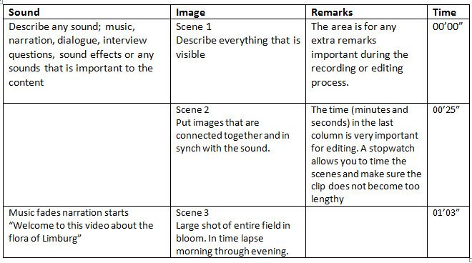
How to develop the video
Script clip beforehand!!!!!
Notes:
Make always a script before you start your production. The shown four columns script combines the sound and the visual material in time.
In the third column remarks are listed to consider during production e.g what should be ready or preparated at that time.

Slide 43

Possible follow ups
Contact us for advice & support
  id_elearning@maastrichtuniversity.nl
Join the Video in Education Workshop (CPD)
  May 14 EDLAB Details and sign up – Video design theory & editing
Join our workshop scenario & script writing
  Interested? Mail id_elearning
  Date will be set
    whenever a group > 5
From: https://pixabay.com/

Slide 44

Discussion or questions
From: https://pixabay.com/

Slide 45
Usefull websites
http://videum.library.maastrichtuniversity.nl/
https://www.kuleuven.be/english/education/educational-policy/limel/training-platform
Knowledge portal about Media and Education: https://www.media-and-education.nl/weblectures/variant
Knowledge clip about making of a knowledge clip (Dutch): https://hva.mediamission.nl/Mediasite/Play/b2a5f0a4f4c64569a1222d0a761a9c5a1d

